Slide 1
Working Title
Simon Schuster k01612746
Florian Mader k01642918

Slide 2
Idea
An app to help organisations take orders and serve food.
Manage Tables, Food and Orders
Create Bills
Show Statistics

Slide 3

Related Apps
Unintuitive UI
Difficult setup
Expensive

Slide 4
Target Group
Firefighters
Music union
Sport clubs

Slide 5
Technology Stack
PWA (Javascript, Angular)
MongoDB
Raspberry Pi (as Server)
Sensors:
Camera
Stepcounter (Motion Sensor)

Slide 6
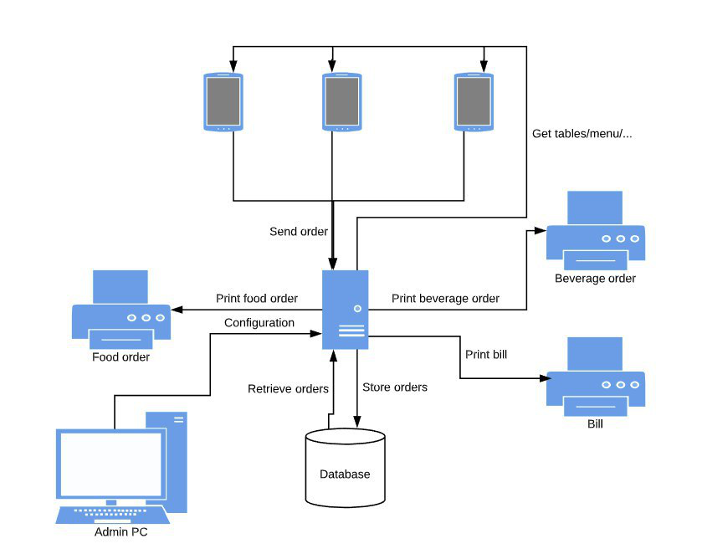
Architecture

Slide 7
Agenda
Deadline | Task
06.11.2019 | Project Proposal
11.12.2019 | Mock-ups
20.12.2019 | Proof on Concept of Sensor implementation
22.01.2020 | First Prototype
29.01.2020 | Final Presentation
31.03.2020 | Final Product (first stable Version)
XX.04.2020 | Finish Testing
XX.04.2020 | First rollout on live system for firefighter feast

